Slide 1
NetFlow Analysis with Elastic Stack
Elasticsearch Seoul Meetup
me@madkoala.net

Slide 2

Presenter
manager at SK broadband
me@madkoala.net
I don’t have any f**king Btv coupons!

Slide 3
What is NetFlow?
Cisco router feature that provides the ability to collect IP network traffic information on interfaces
Main components
Flow Exporter
Flow collector (logstash)
Analysis application (elasticsearch)
Visualization (kibana or whatever works)
Source: Wikipedia

Slide 4
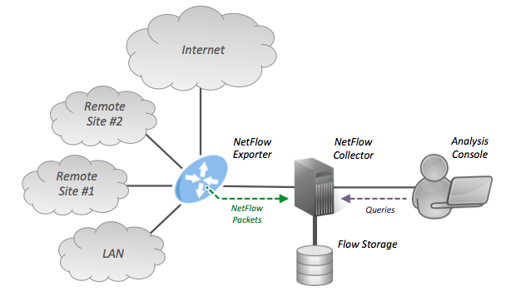
NetFlow Architecture
Source: Wikipedia

Slide 5
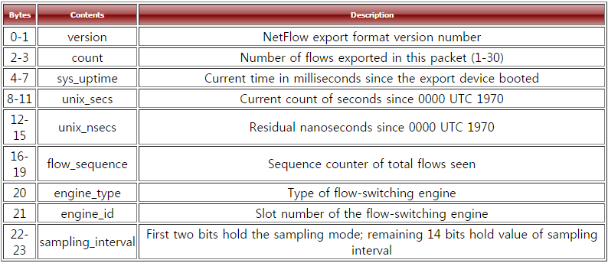
NetFlow Protocol (v5 header)
Source: https://www.plixer.com/support/netflow_v5.html

Slide 6
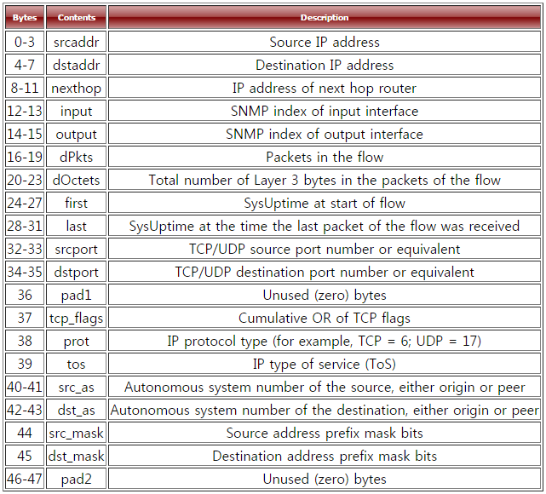
NetFlow Protocol (v5 record)
Source: https://www.plixer.com/support/netflow_v5.html

Slide 7
What we can do with NetFlow
Application usage analysis
Troubleshoot network problem
Track down bandwidth hogs
Detect abnormal traffic usage
Detect hosts infected by malwares
…

Slide 8
Elastic Stack - NetFlow
Logstash: NetFlow collector
Elasticsearch: NetFlow storage & analysis
Kibana: Visualization

Slide 9
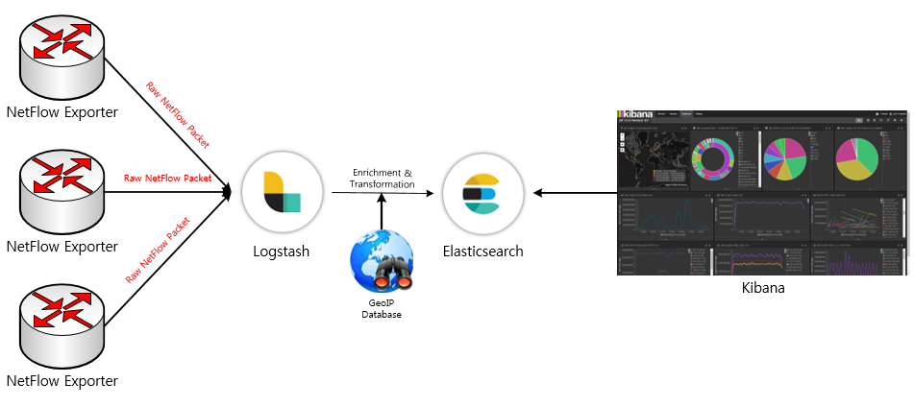
System Architecture
이보다 더 간단할 수 없다.

Slide 10
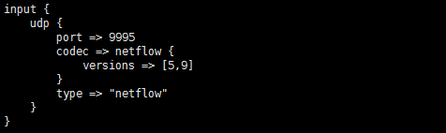
Logstash Configuration (input)

Slide 11
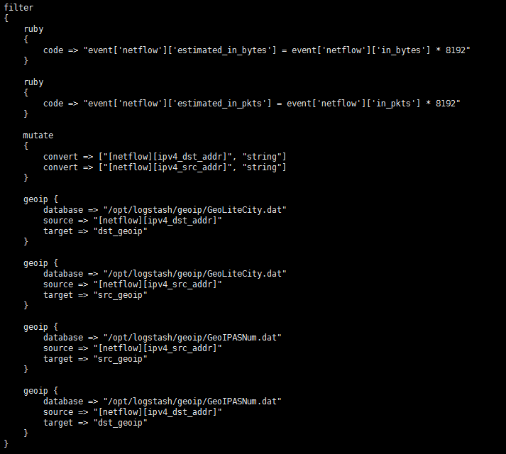
Logstash Configuration (filter)
Calculate estimated traffic volume
(need to consider sampling rate)
➔ Enrichment with geolocation info

Slide 12
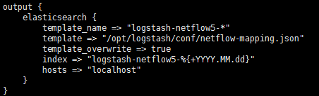
Logstash Configuration (output)

Slide 13
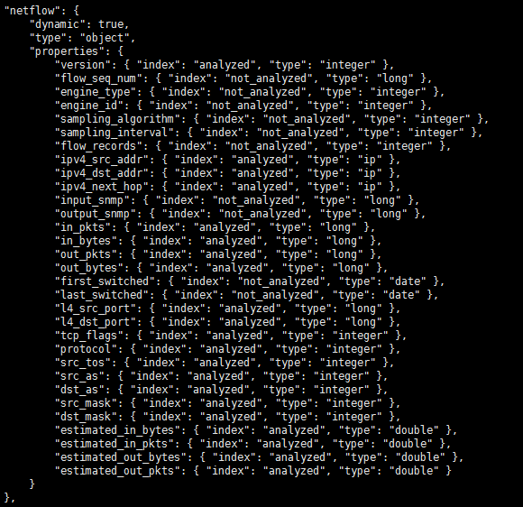
Template for NetFlow data

Slide 14
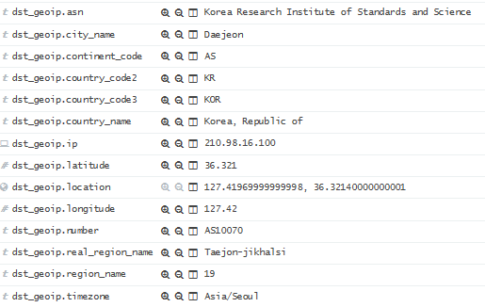
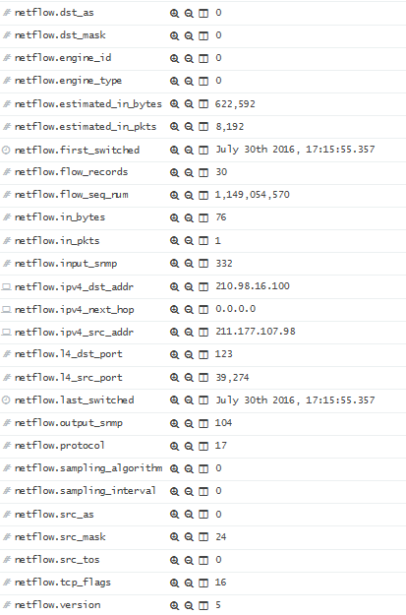
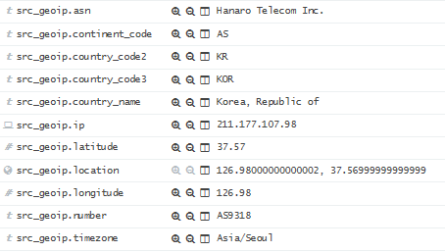
Collected data sample

Slide 15
Demo! Demo!! Demo!!!

Slide 16
Thank you.

